Slide 1
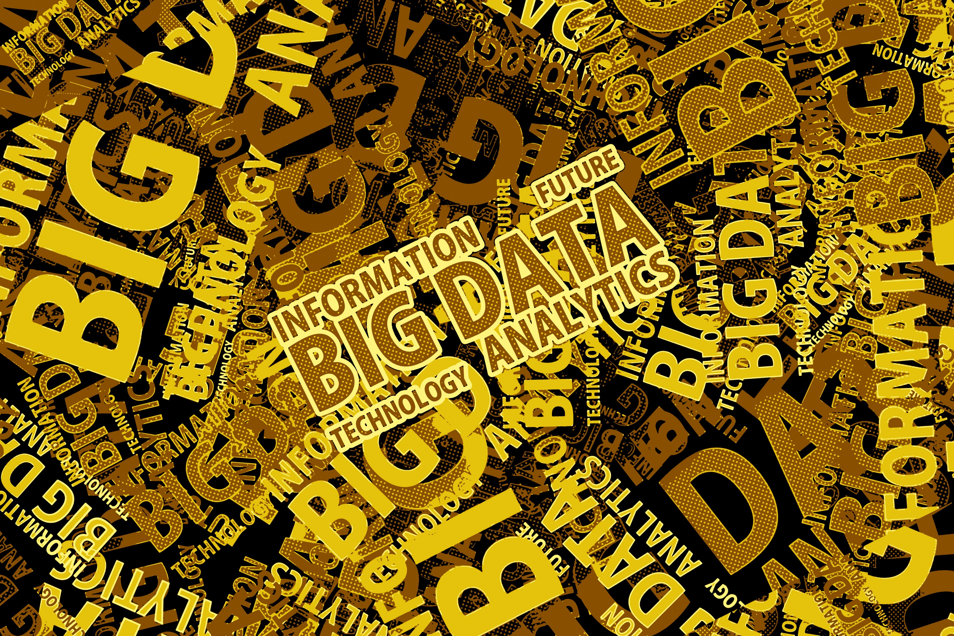

INTRODUCTION TO PYTHON
FACILITATOR Kolawole David Olanipekun

Slide 2
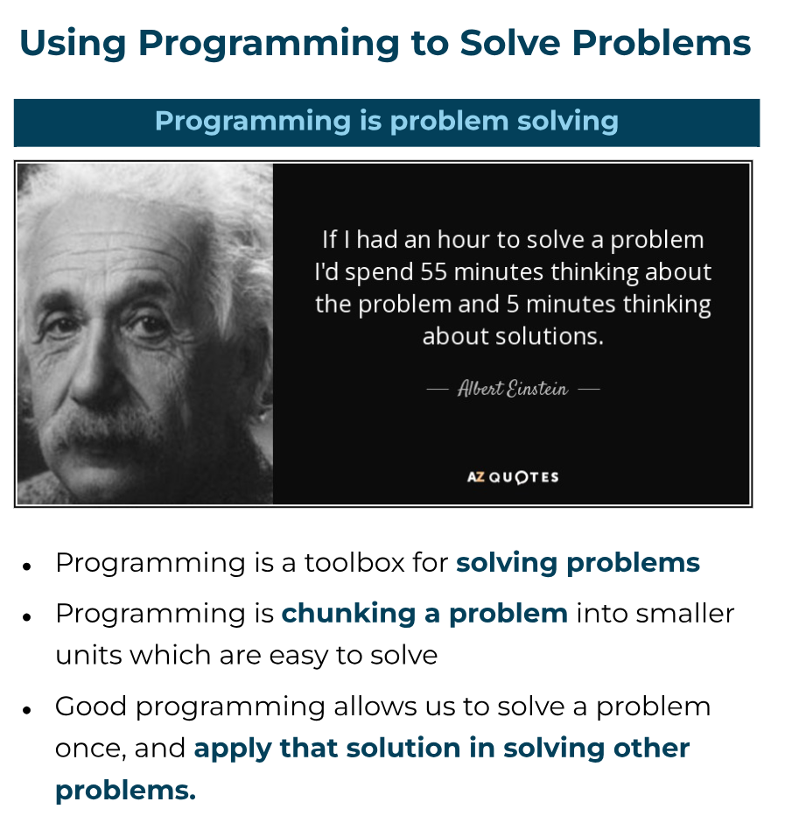
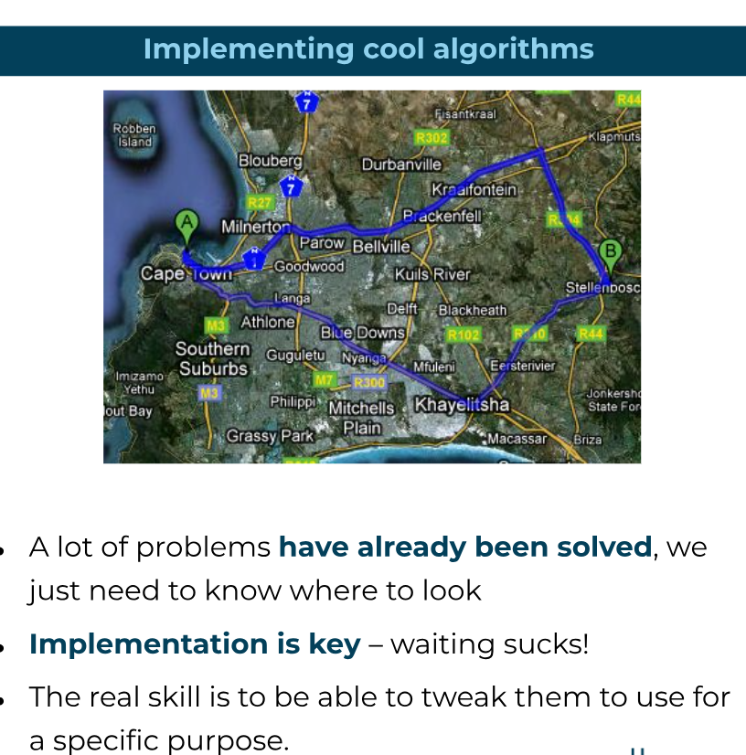
OVERVIEW

Slide 3
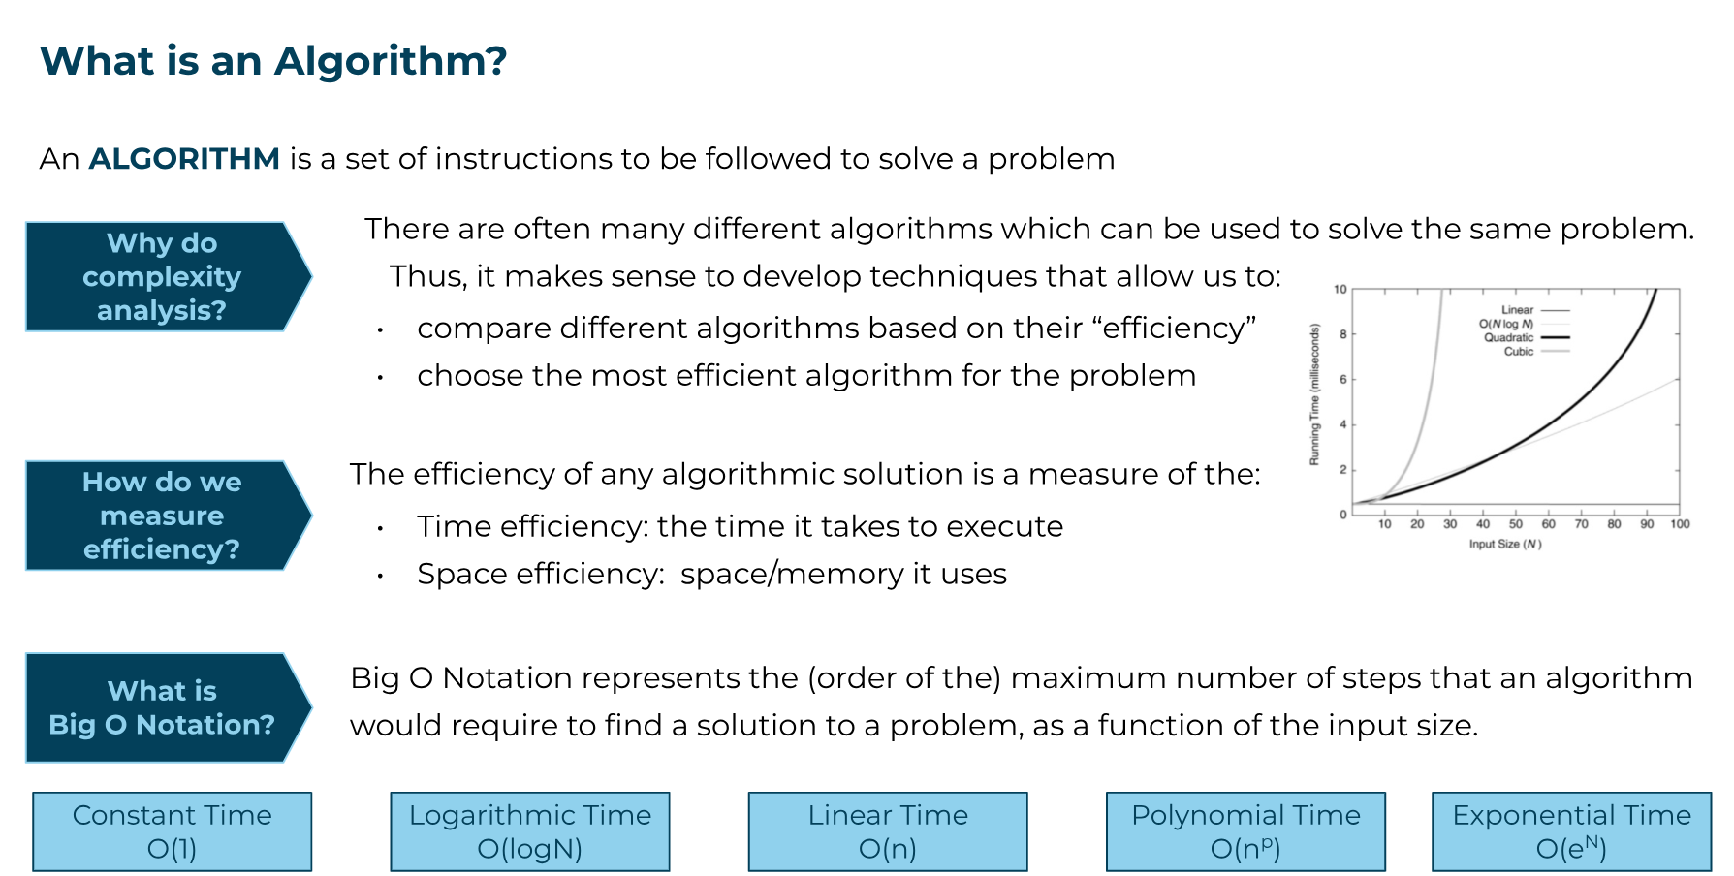
OVERVIEW| ALGORITHM

Slide 4
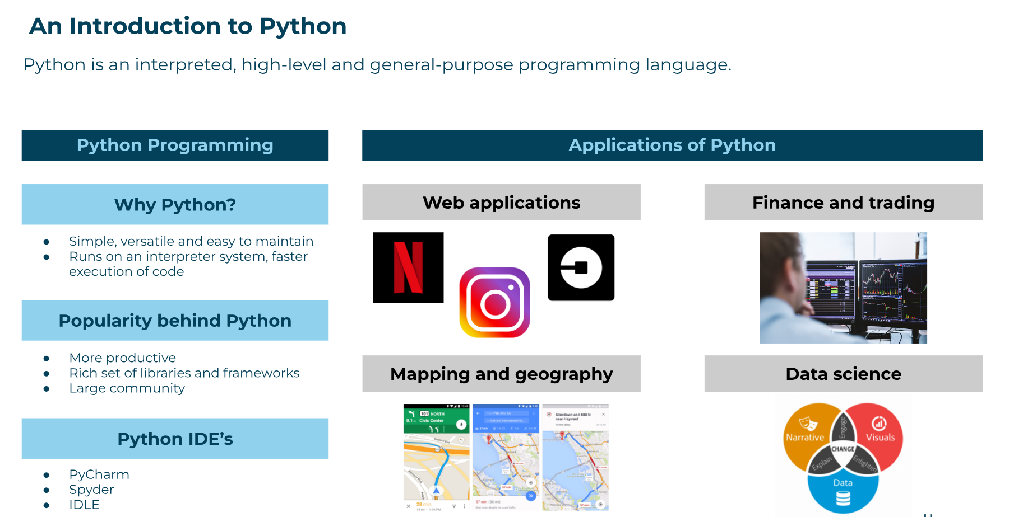
OVERVIEW| INTRODUCTION TO PYTHON

Slide 5
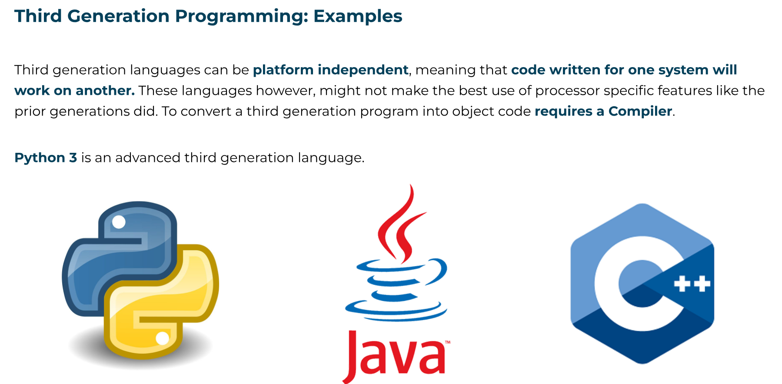
OVERVIEW| INTRODUCTION TO PYTHON

Slide 6
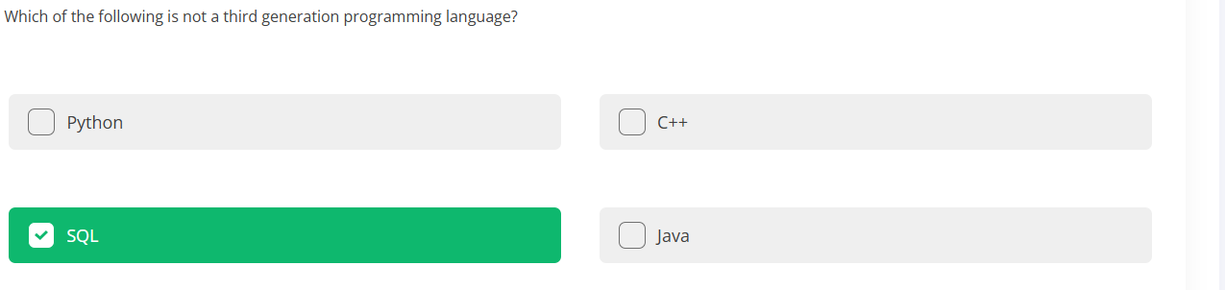
OVERVIEW| INTRODUCTION TO PYTHON

Slide 7
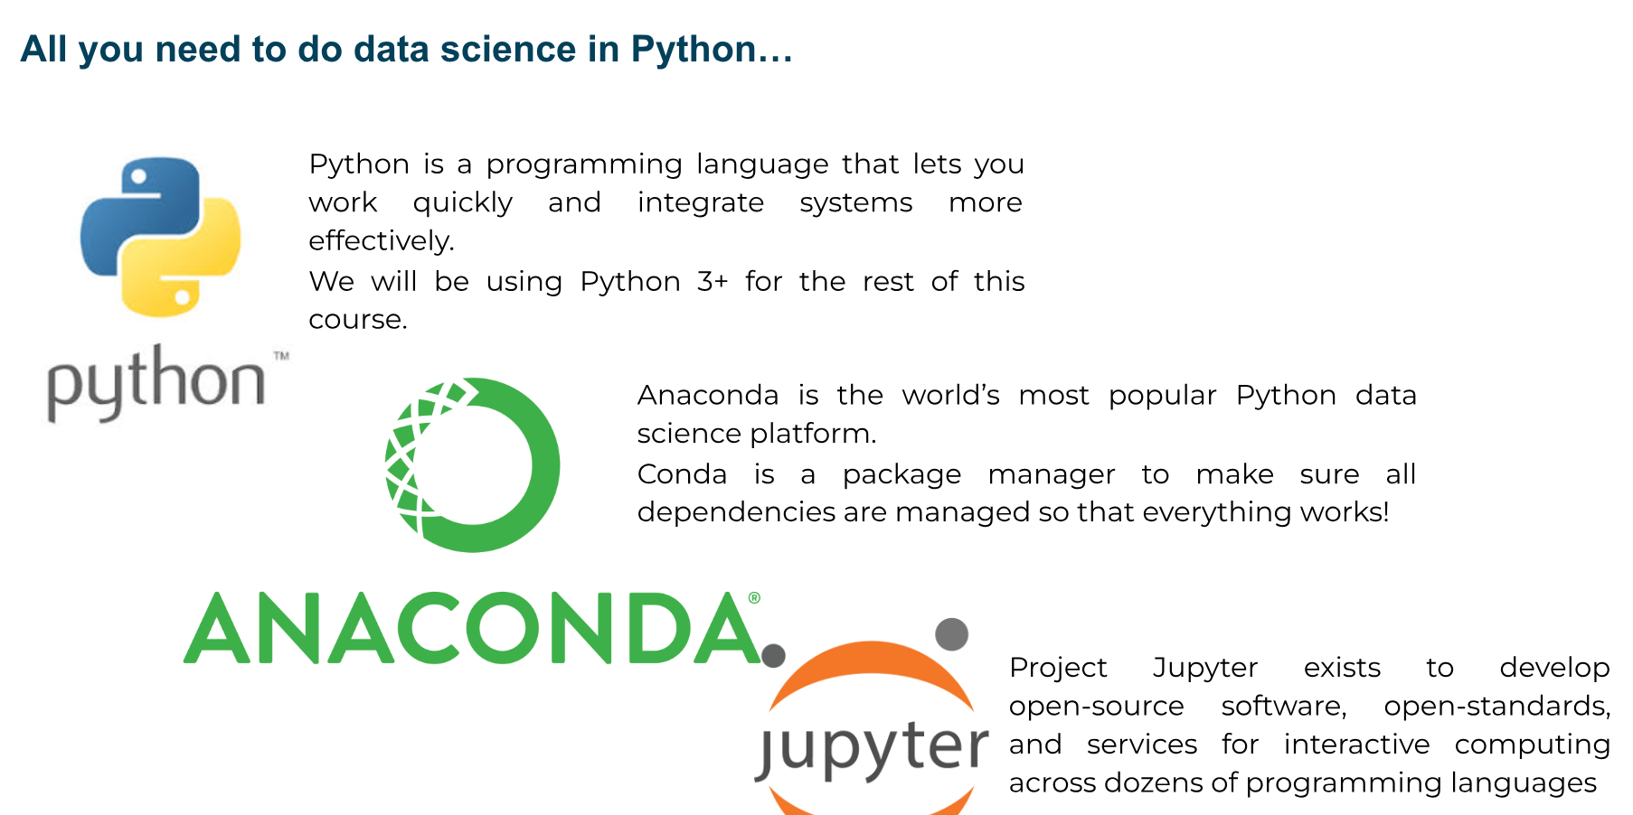
OVERVIEW| INTRODUCTION TO PYTHON

Slide 8
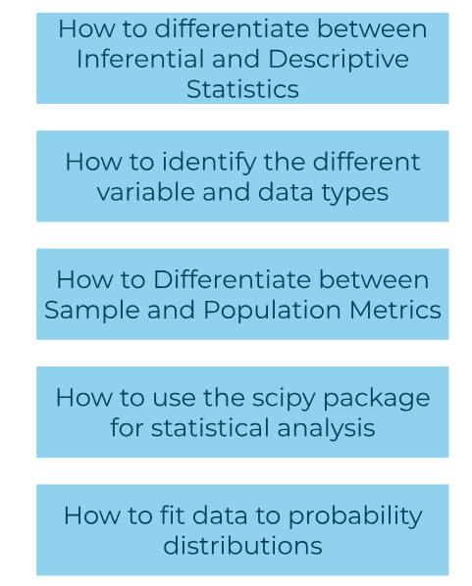
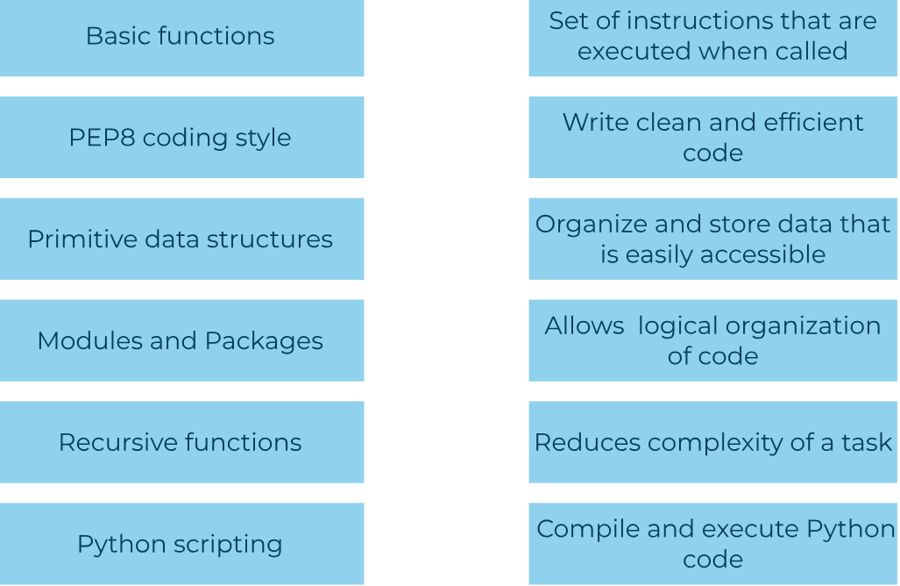
OVERVIEW| KEY CONCEPTS IN PYTHON
ESSENTIAL CONCEPTS IN PYTHON TO SUCCEED IN DATA SCIENCE

Slide 9
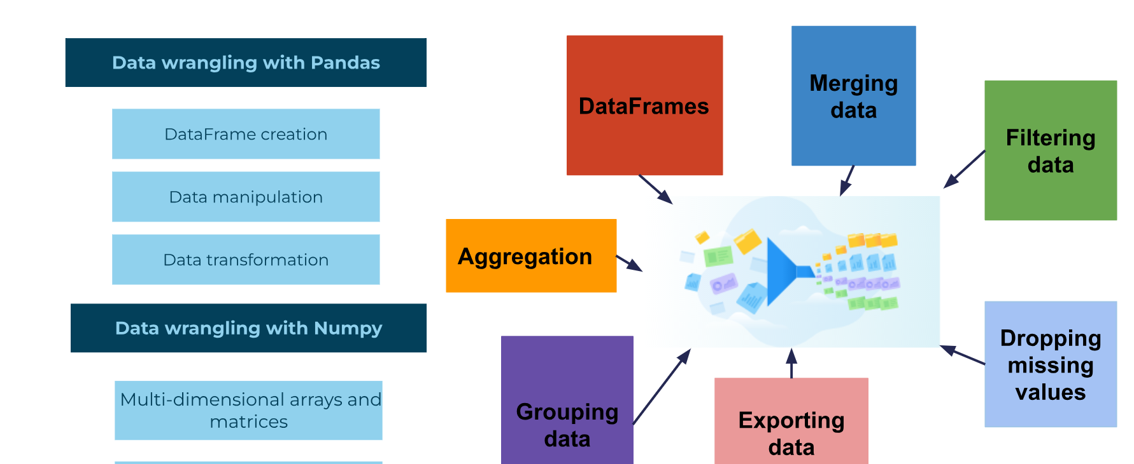
OVERVIEW| KEY CONCEPTS IN PYTHON
ESSENTIAL CONCEPTS IN PYTHON TO SUCCEED IN DATA SCIENCE

Slide 10
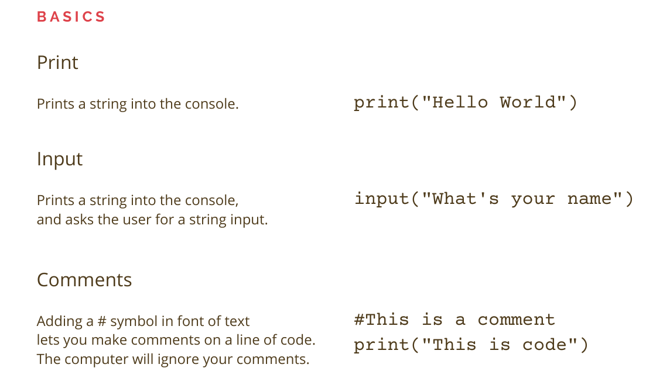
BASICS OF PYTHON

Slide 11
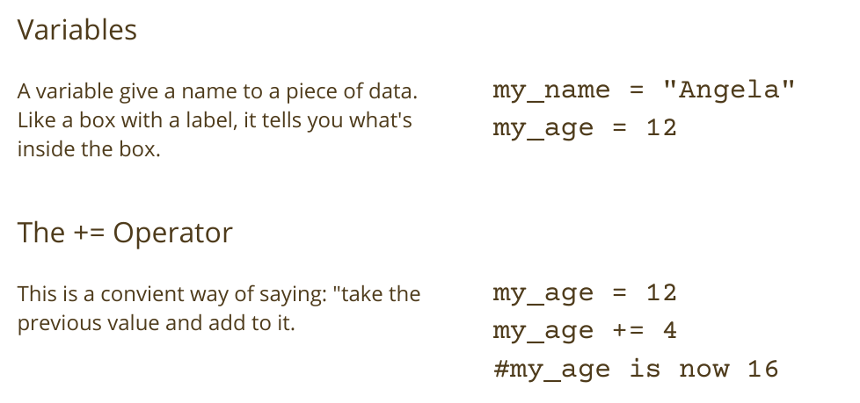
BASICS OF PYTHON

Slide 12
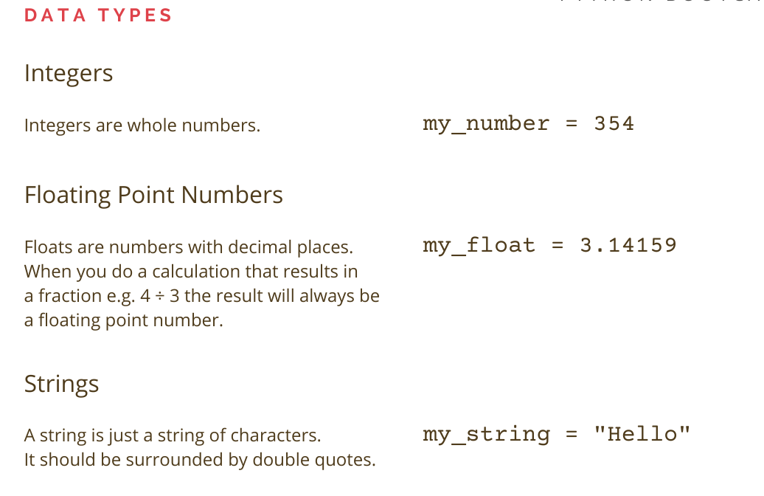
BASICS OF PYTHON

Slide 13
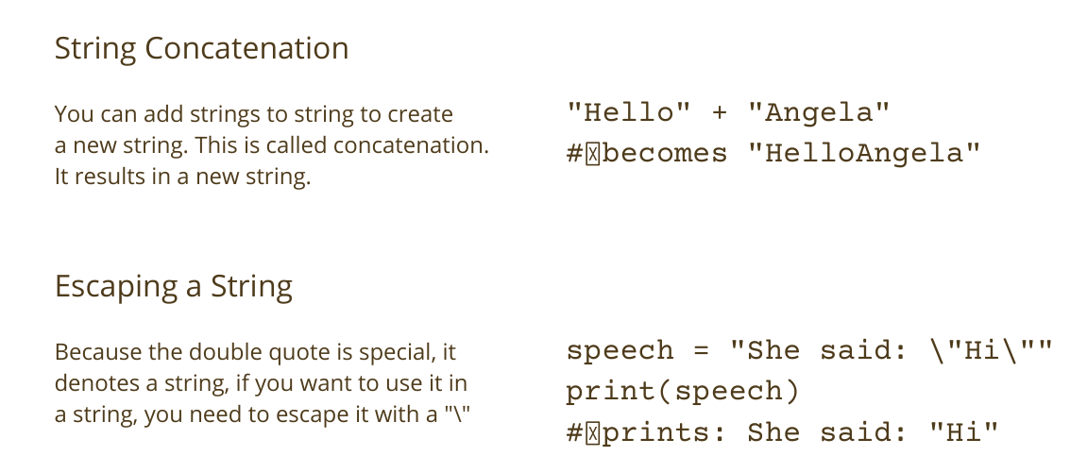
BASICS OF PYTHON

Slide 14
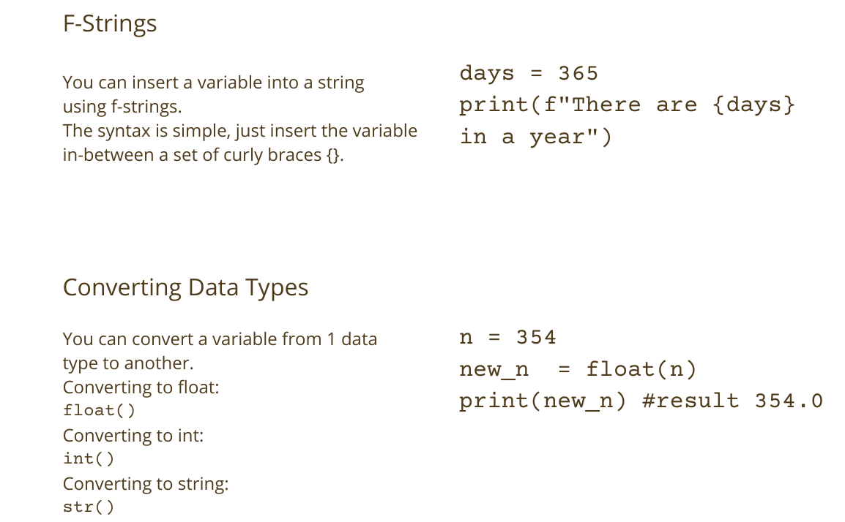
BASICS OF PYTHON

Slide 15
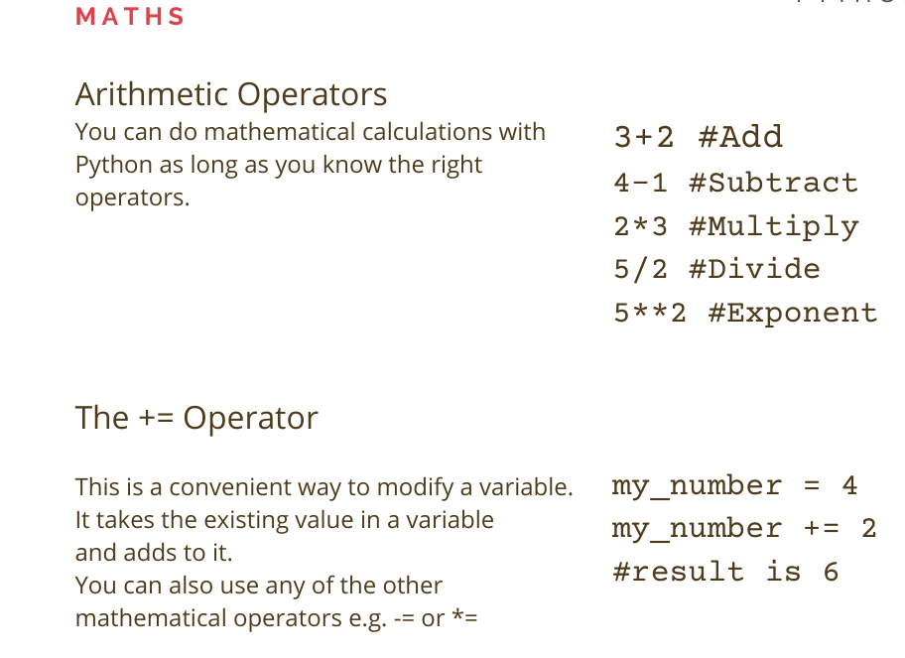
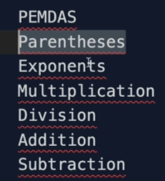
BASICS OF PYTHON

Slide 16
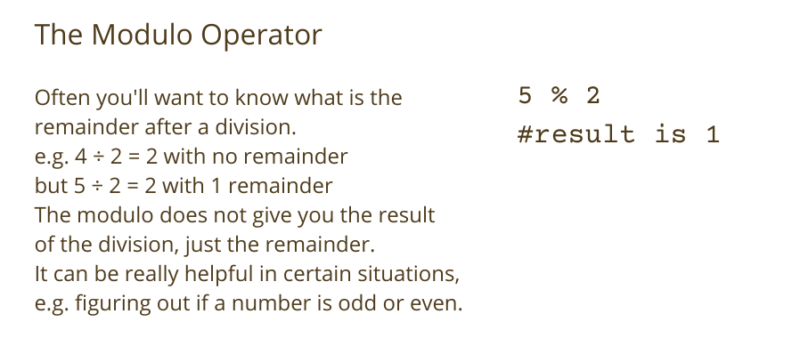
BASICS OF PYTHON

Slide 17
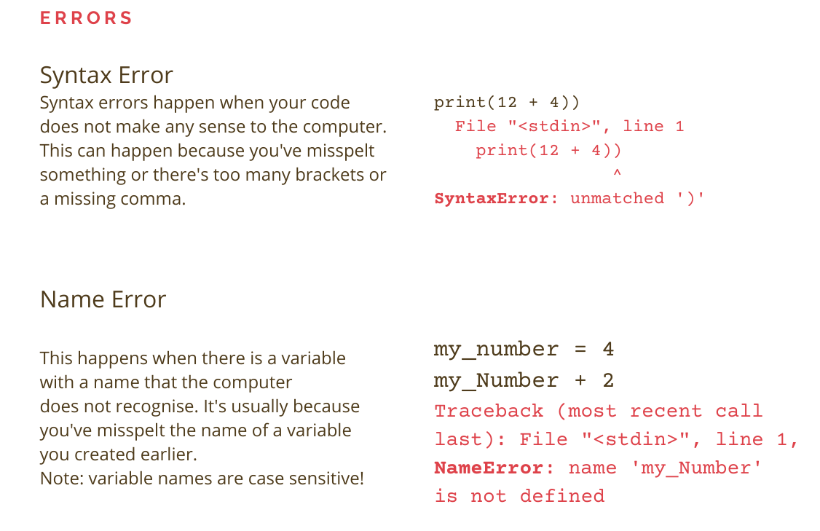
BASICS OF PYTHON

Slide 18
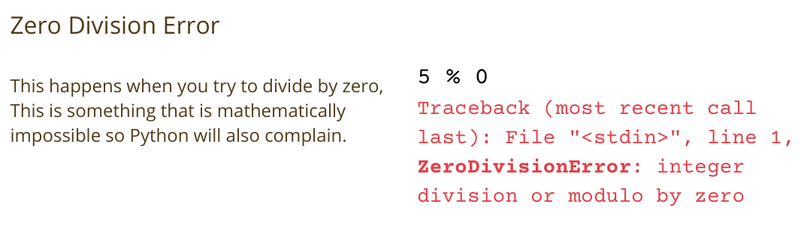
BASICS OF PYTHON

Slide 19
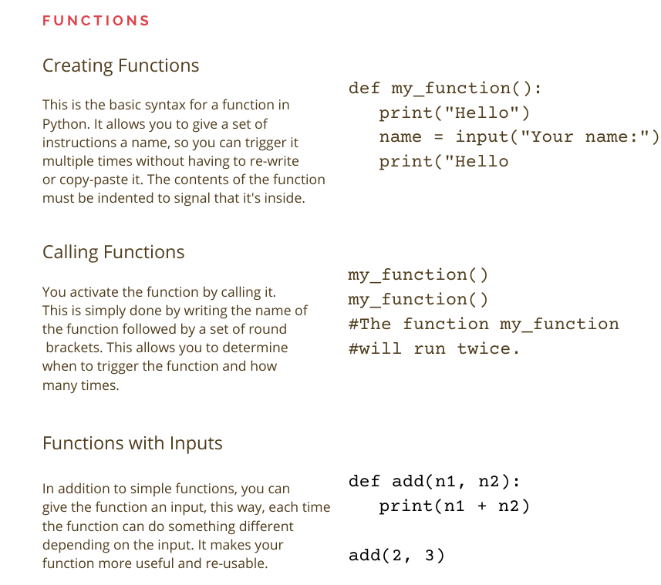
BASICS OF PYTHON

Slide 20
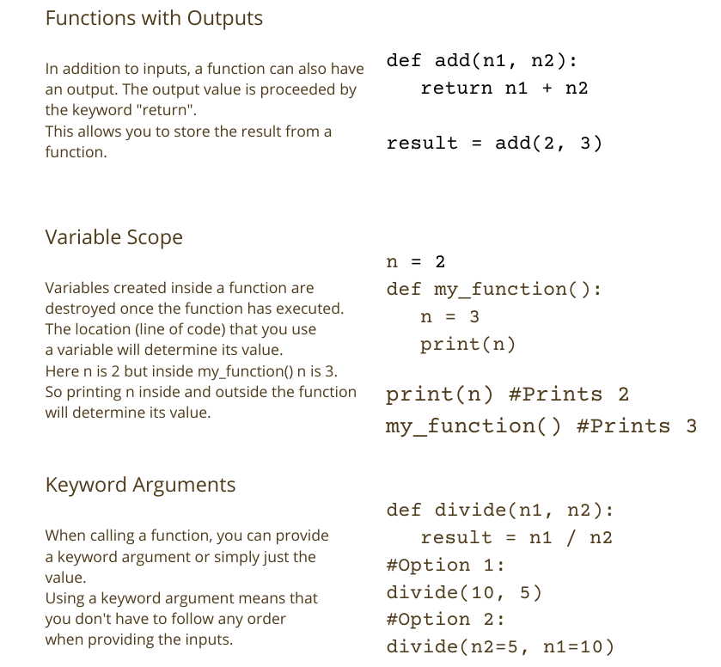
BASICS OF PYTHON

Slide 21
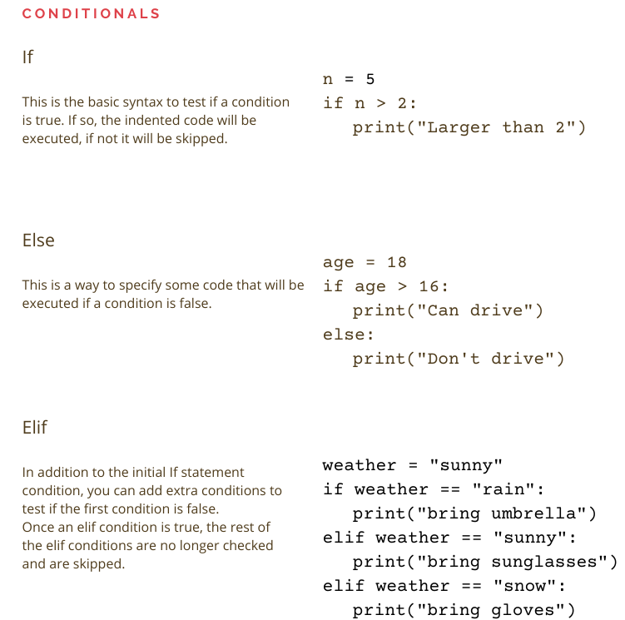
BASICS OF PYTHON

Slide 22
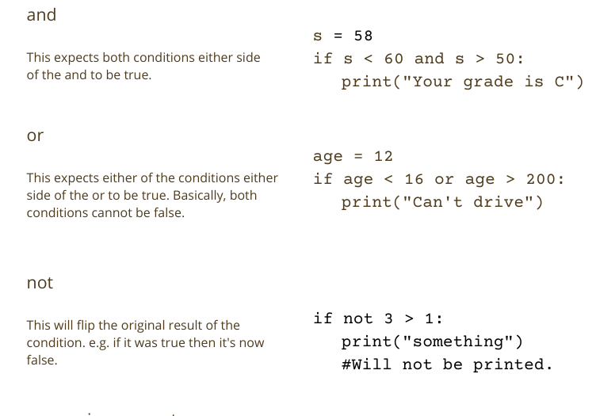
BASICS OF PYTHON

Slide 23
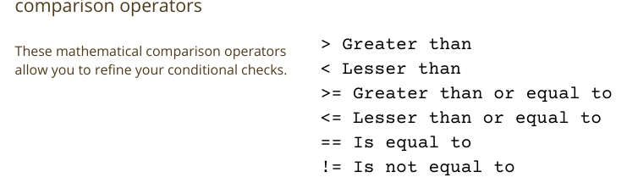
BASICS OF PYTHON

Slide 24
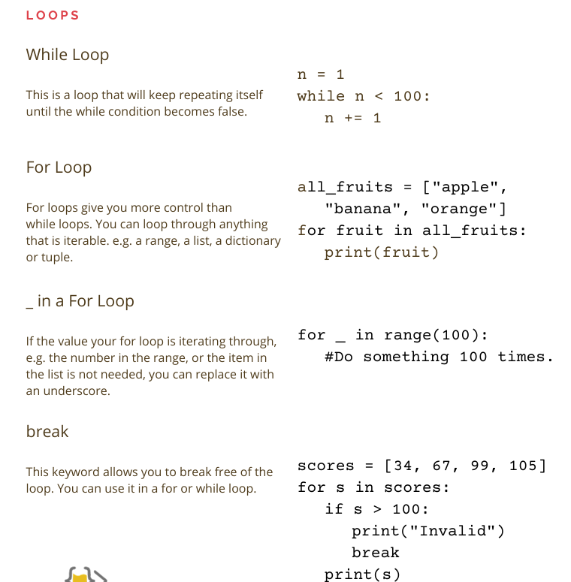
BASICS OF PYTHON

Slide 25
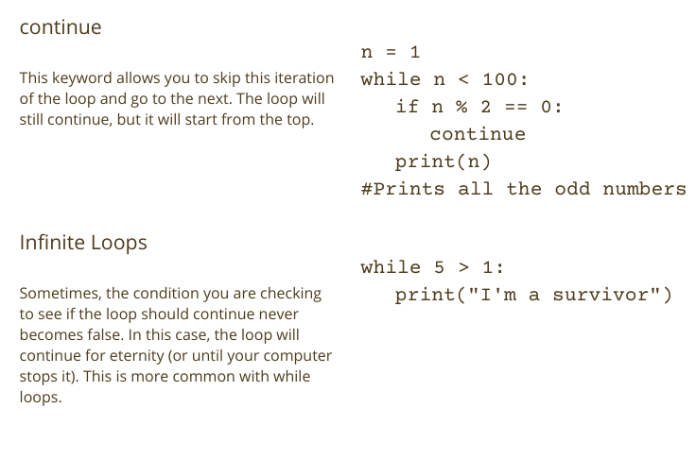
BASICS OF PYTHON

Slide 26
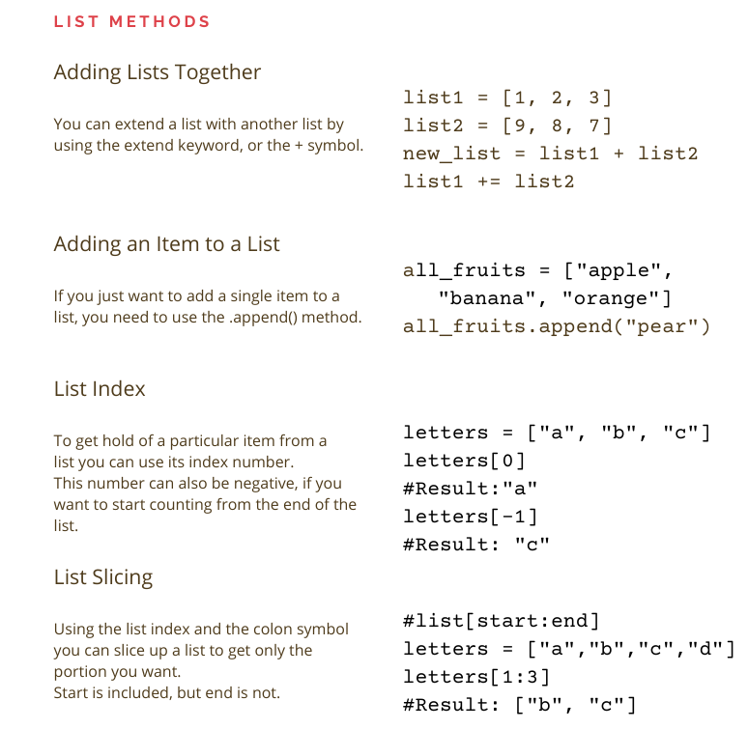
BASICS OF PYTHON

Slide 27
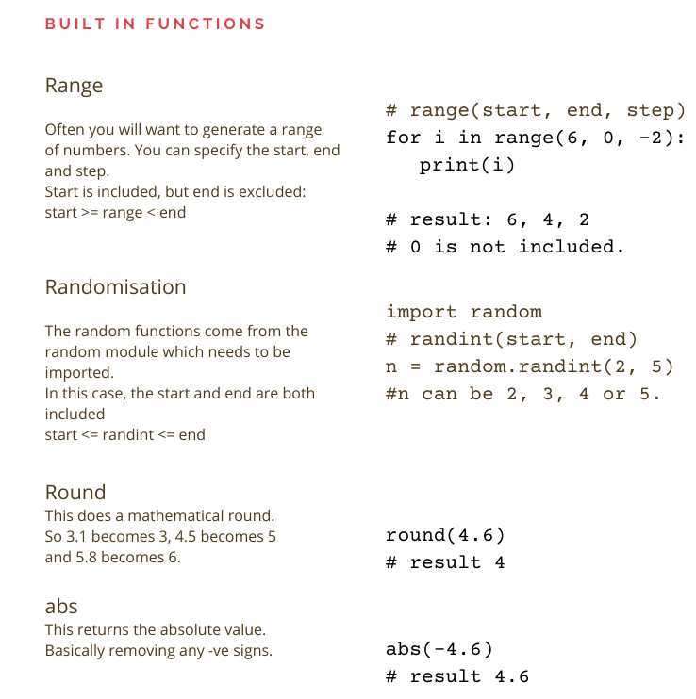
BASICS OF PYTHON

Slide 28
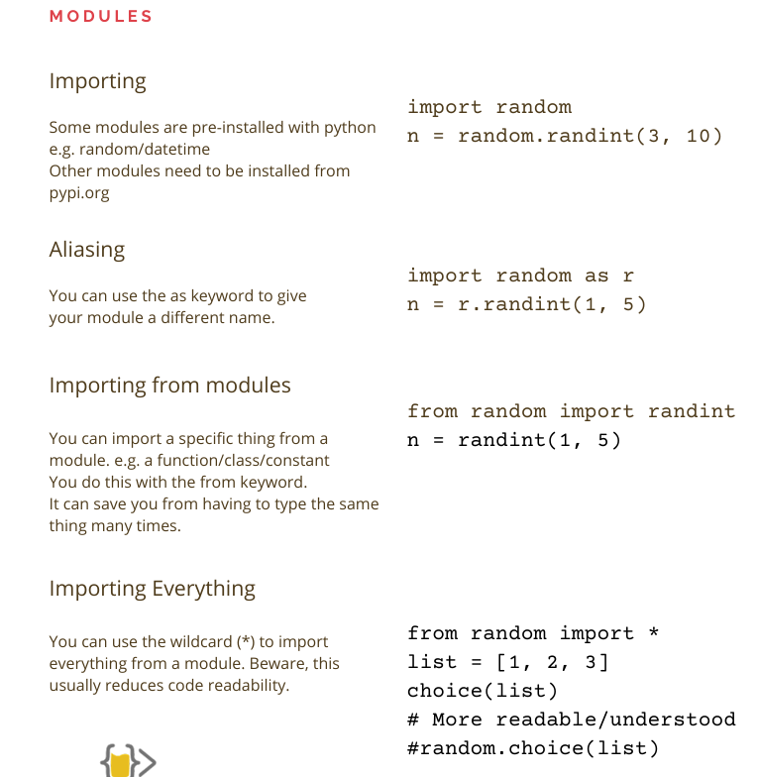
BASICS OF PYTHON

Slide 29
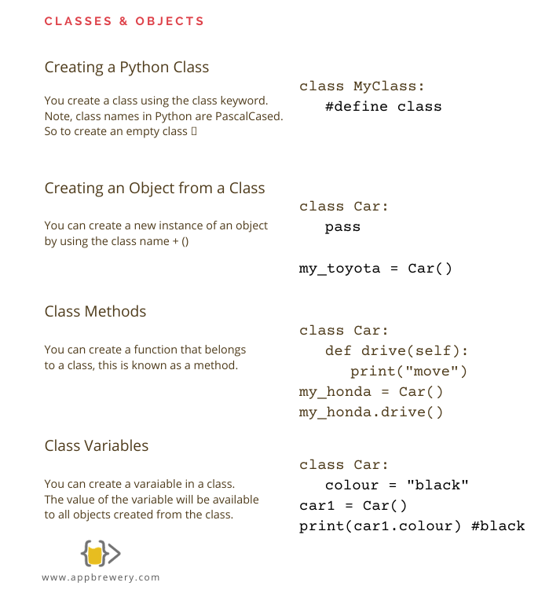
BASICS OF PYTHON

Slide 30
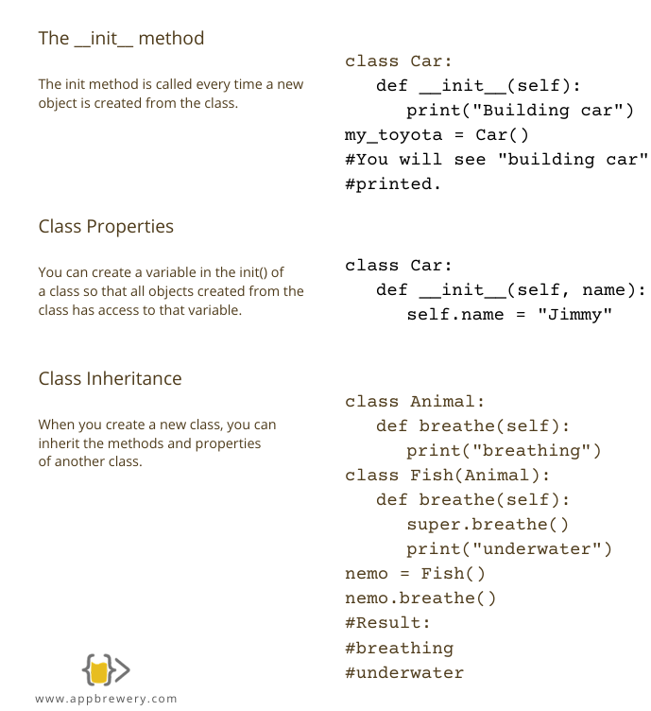
BASICS OF PYTHON

Slide 31
